Slide 1

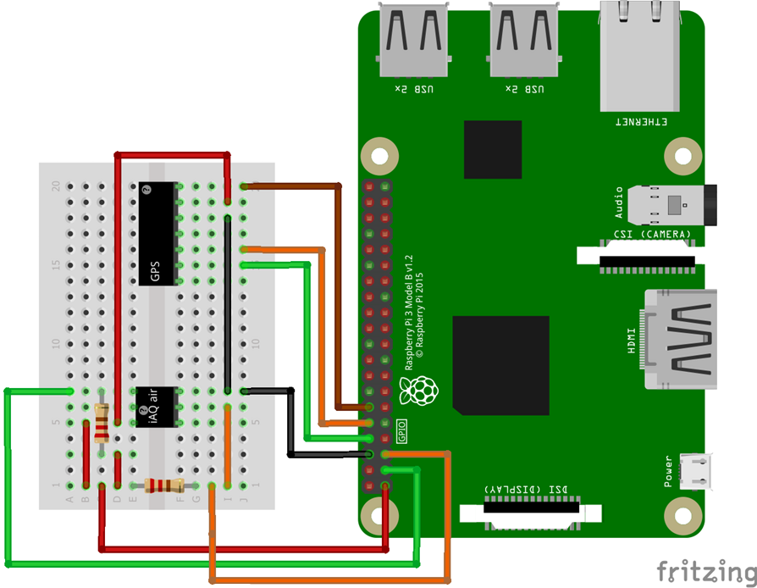
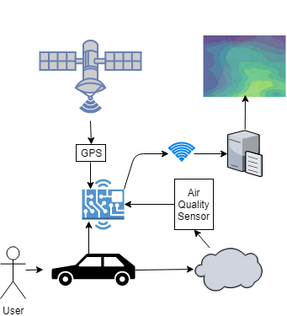
Air Quality Mapping
Robert Mouncer
rdm10@aber.ac.uk
Technical Information
The GPS module uses a universal asynchronous receiver-transmitter (UART) protocol to communicate data to the Raspberry Pi. The Air quality sensor uses a I2C protocol to communicate with the Raspberry Pi. Both of these protocols are very well known and luckily a lot of support is available online. Having very little knowledge of hardware and protocols, the support online has pushed me in the right direction to connect the hardware up correctly and begin communicating with the components.
The Raspberry Pi is running Raspbian LITE, a lightweight GUI-free Linux distribution. This is due to the monitoring system not needing a GUI once completed. Another benefit was to increase my experience with Linux command line.
For development a samba server has been set up to use the standard client-server setup, development can be done on an operating system with a GUI over a network and then can be tested using SSH to run the software.
Two separate python scripts will be created to run the monitoring system. One will collect data from the two hardware components and save them as a file. The other script will upload the files once the device is within range of WLAN. The two scripts will automatically be run using crontab jobs.
The visualisation tool will be a web-based application using an online map provider API such as Google Maps or Open Street Map with an overlay showing the air quality levels in different locations. Planning and design for this web-based application has not yet been completed.
Project Information
With our improving knowledge on pollution and climate change, it has become more apparent that many health issues can be related to pollution in the air causing poor air quality.
Roughly 40,000 people in the United Kingdom die annually from causes related to pollution, 9,000 of these deaths are in London alone. China has one of the highest death rates due to air pollution with 1.6 million deaths annually.
A necessary action needed to improve the air quality according to the royal college of physicians is to “monitor air pollution effectively” in urban areas then “these results should be communicated proactively to the public”.
This Major Project for my Aberystwyth University degree aims to complete this action by developing a monitoring and visualisation system for air pollution in public areas. A device installed in vehicles will take air quality measurements and match the data to a GPS location. Once the device is within range of a known WLAN it will upload the data to a server.
The data can then be used with the visualisation tool to educate people about the air quality in their surrounding areas. The visualisation tool will use an online map provider to show the location and an overlay of a contour plot.
The Raspberry Pi hardware is complete and the software is currently being developed. No work has currently been done for the visualisation tool.
Due to the extent of this project, all harmful gases cannot be measured so volatile organic compounds will be measured and a C02 approximation can be made. The project will be classed as a “proof of concept”
Remaining and Future Work
The software development for the Raspberry Pi device is almost complete, there was a problem with the hardware connection to the air quality sensor but this has since been fixed and development can continue. The python script to upload the files to the server has not been completed yet and needs to be created.
Either a database or file storage server needs to be created to upload the data collected from the Raspberry Pi device.
The development of the web-based visualisation application has not been started. Research needs to be conducted into the API’s that can be used. The site will be hosted within my /public_html/ directory that Aberystwyth University hosts.
Future work that could be completed after the Major Project submission could be to add additional sensors onto the Raspberry Pi device to detect harmful gases and not just TVOC (total volatile organic compounds). The data could be used in future with machine learning techniques to estimate the pollution in areas that data hasn’t been collected.
Further Information
A blog descripting my process through the major project Is live at http://users.aber.ac.uk/rdm10/wordpress/ but is not updated as frequently as it should be.
The documents and source code are being version controlled using Git and are hosted on GitHub. The current repository is set to private but will be made public after the submission of the major project.
References
UK Map image, Accessed – 07/03/2018 - https://pixabay.com/en/uk-england-country-map-london-2178613/
The Royal College of Physicians (Published 2016) - Every breath we take: the lifelong impact of air pollution, Accessed – 01/02/2018 https://www.rcplondon.ac.uk/projects/outputs/every-breath-we-take-lifelong-impact-air-pollution
Google Developers (2018), Google Maps APIs, Accessed 11 Feb. 2018 https://developers.google.com/maps/
Wiki.openstreetmap.org. (2018). API v0.6 - OpenStreetMap Wiki, Accessed – 01/02/2018 https://wiki.openstreetmap.org/wiki/API_v0.6 .

